Slide 1
Week 2 Material

Slide 2
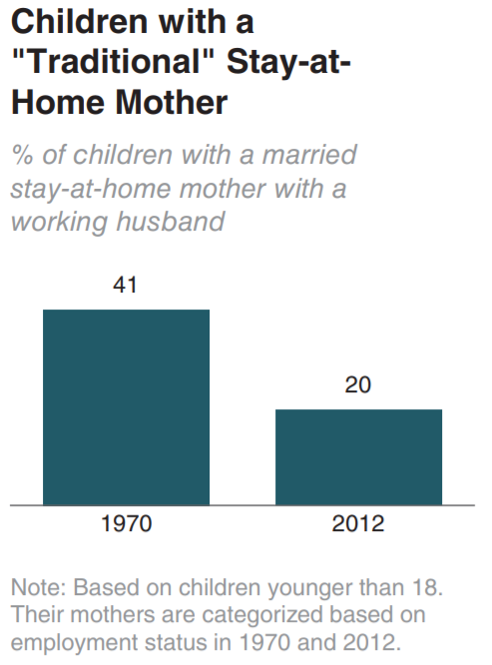
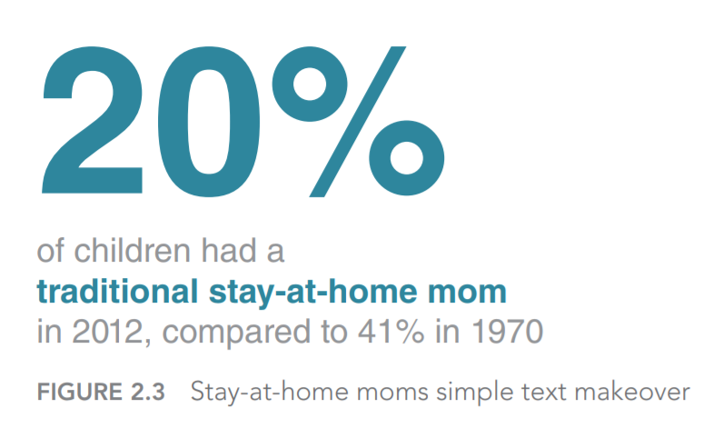
Choosing the effective visual
Use simple text whenever possible

Slide 3
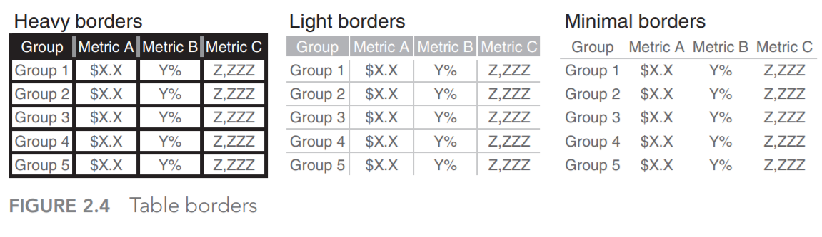
Choosing the effective visual
We “read” tables – eliminate extra ink.
Simpler better

Slide 4
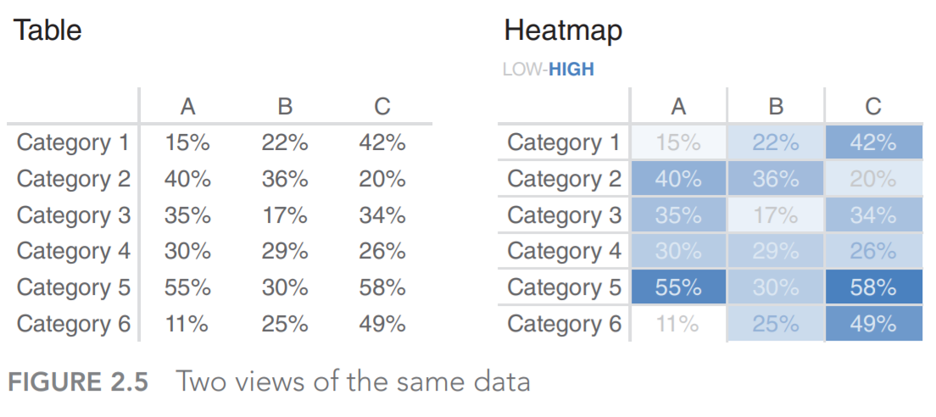
Choosing the effective visual
Heatmaps is the great way to present tables
Use color saturation

Slide 5
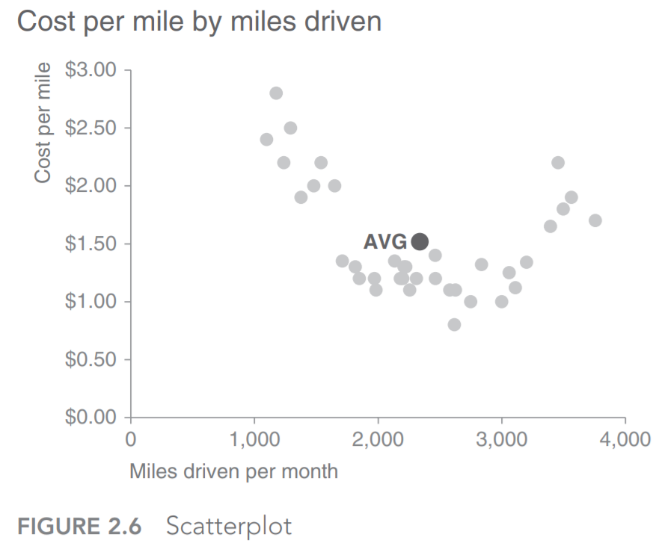
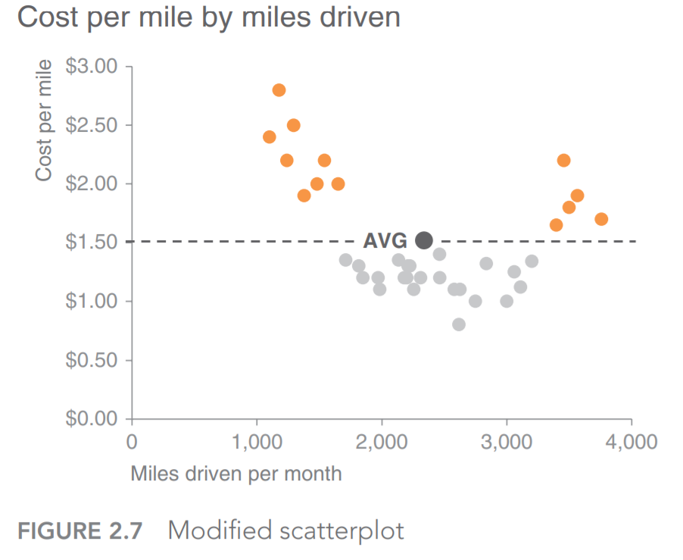
Choosing the effective visual
Graphs – scatterplot
Use color to focus audience attention

Slide 6
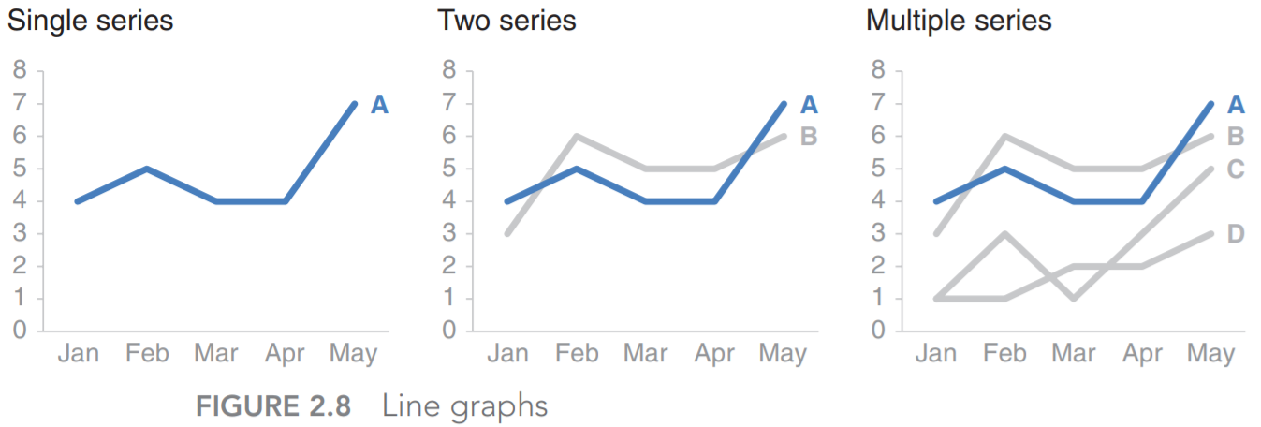
Choosing the effective visual
Graphs - lines

Slide 7
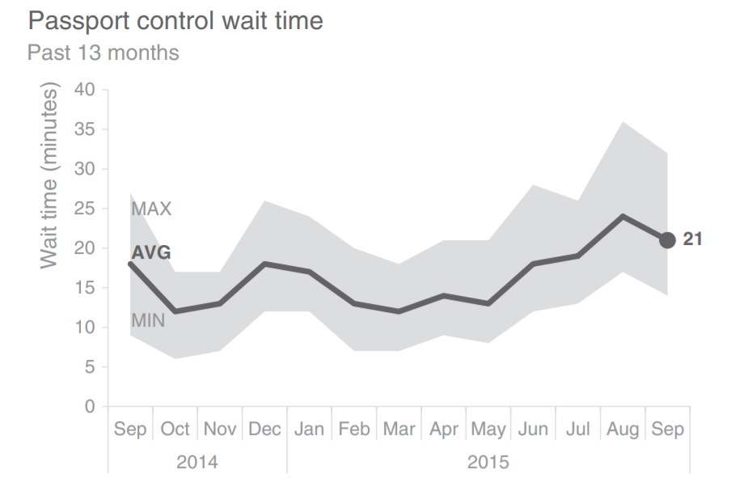
Choosing the effective visual
Graphs – Showing the average within the range

Slide 8
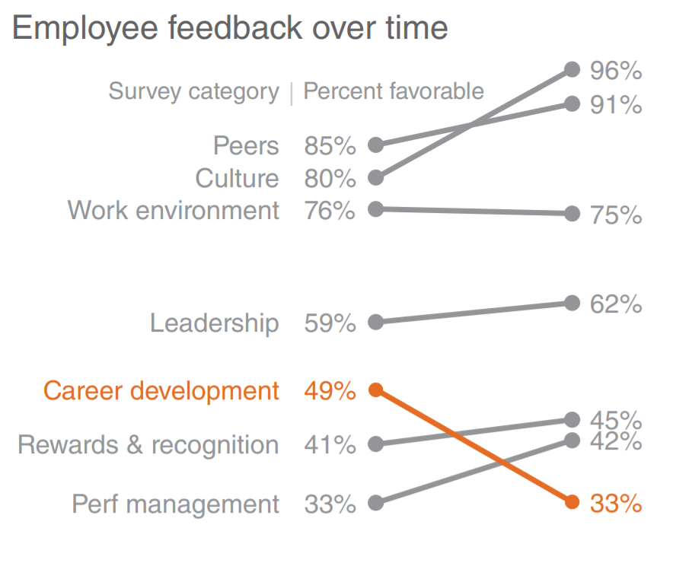
Choosing the effective visual
Graphs - Slopegraph

Slide 9
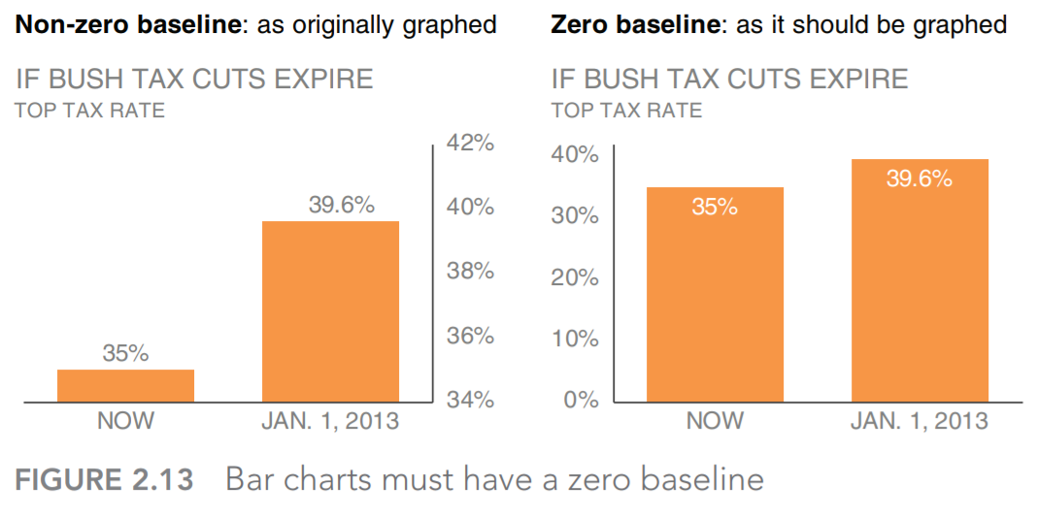
Choosing the effective visual
Graphs – Bar charts

Slide 10
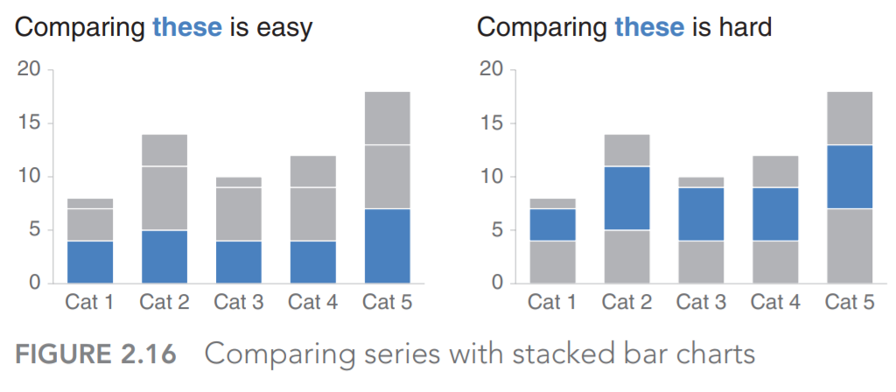
Choosing the effective visual
Graphs – Stacked bar charts – Designed for comparison

Slide 11
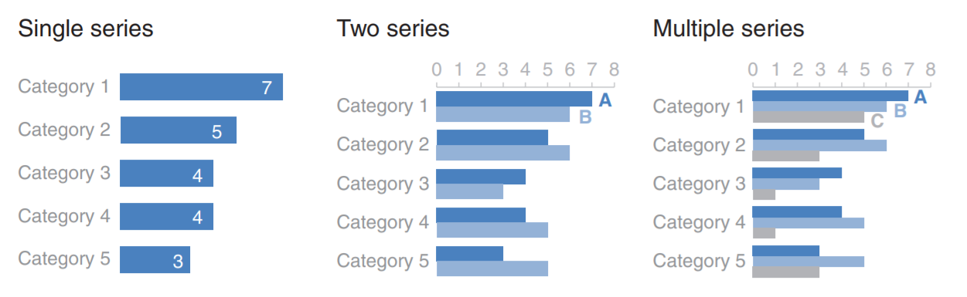
Choosing the effective visual
Graphs – Horizontal bars – Good for ranking

Slide 12
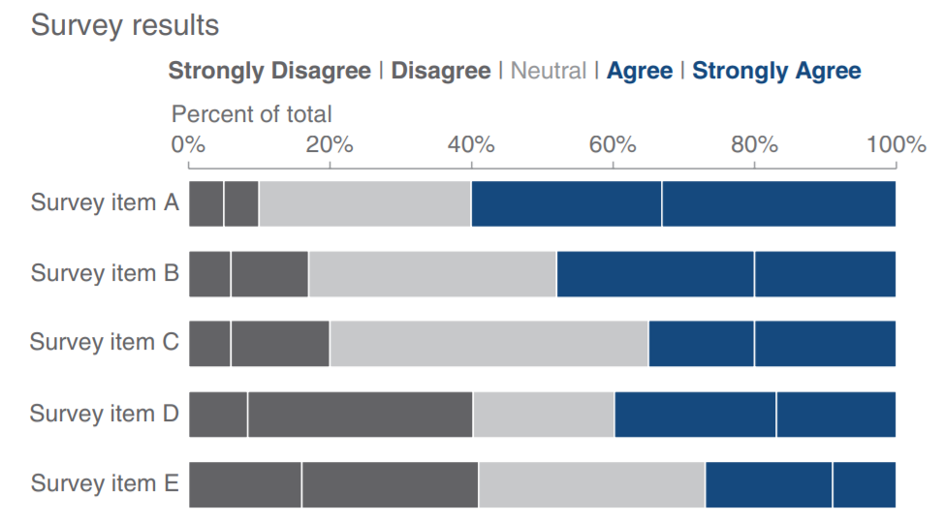
Choosing the effective visual
Graphs – Stacked Horizontal bars – Total across

Slide 13
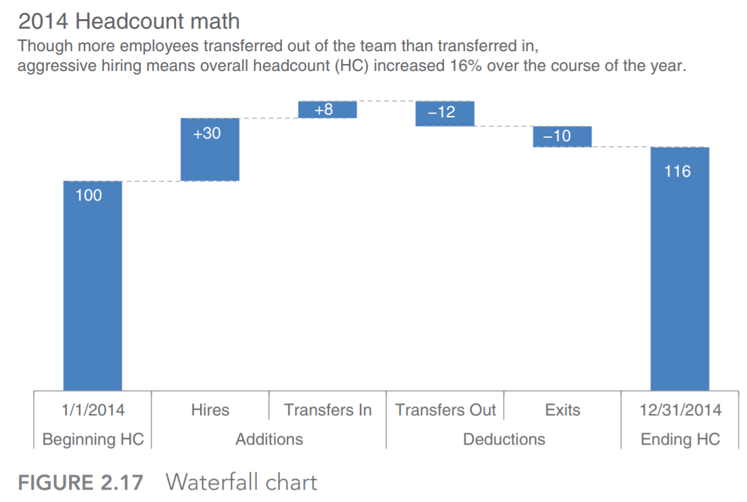
Choosing the effective visual
Graphs – Waterfall charts - attribution

Slide 14
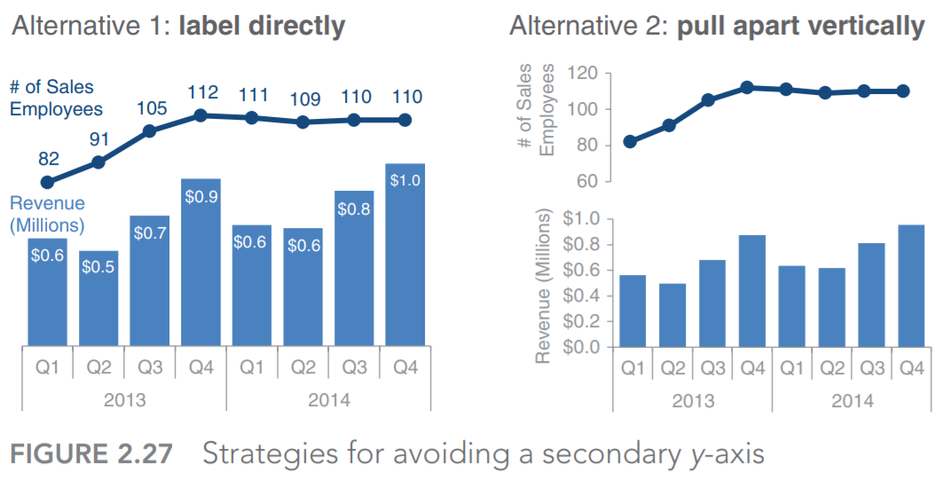
Choosing the effective visual
To avoid
Pie charts
3D
Secondary Y-axes

Slide 15
Clutter is your enemy
Clutter – visual elements that take place but do not enhance understanding
Cognitive load – effort that is required to learn new information
Extraneous cognitive load – processing that takes up mental resources but does not help the audience

Slide 16

Clutter is your enemy
Gestalt principles of visual perception
Proximity – objects that are physically close together belong to a group

Slide 17
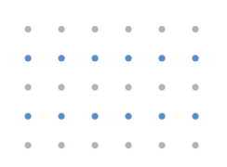
Clutter is your enemy
Gestalt principles of visual perception
Similarity – objects that are the same shape, size, etc. belong to a group

Slide 18
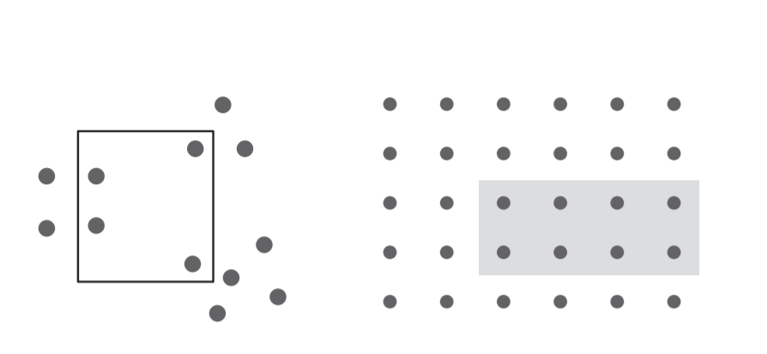
Clutter is your enemy
Gestalt principles of visual perception
Enclosure – objects that are enclosed belong to a group

Slide 19
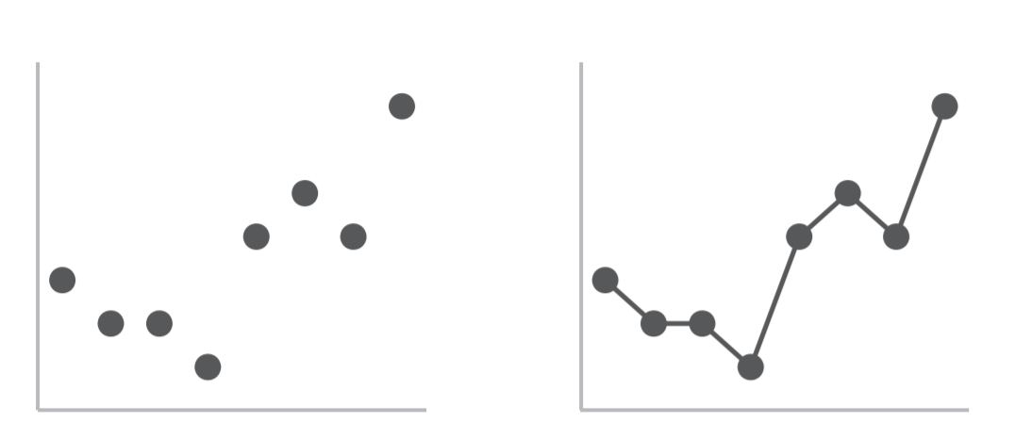
Clutter is your enemy
Gestalt principles of visual perception
Connection – objects that are physically connected are a part of a group

Slide 20
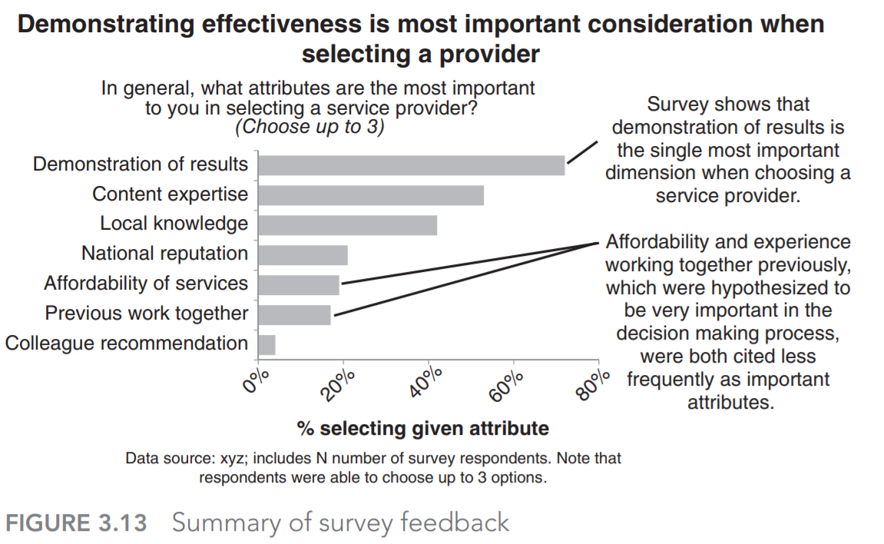
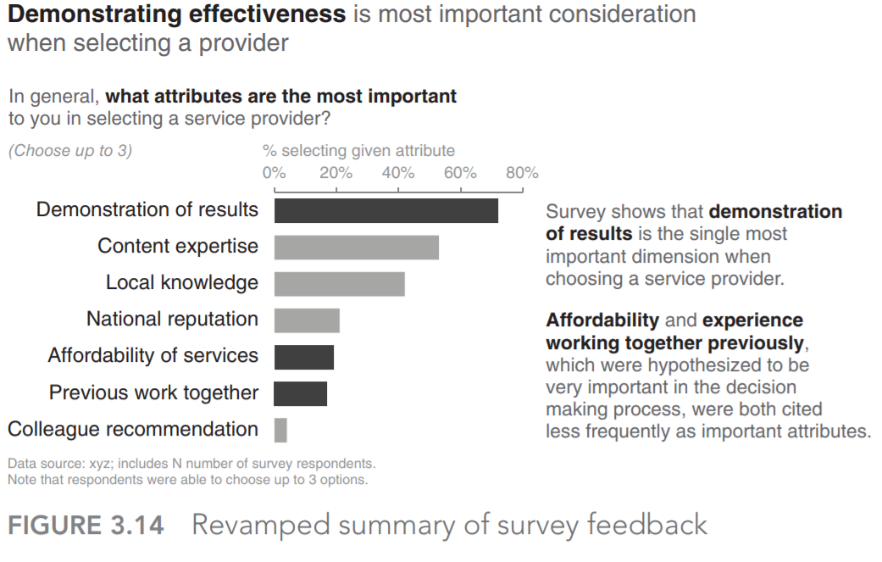
Clutter is your enemy

Slide 21
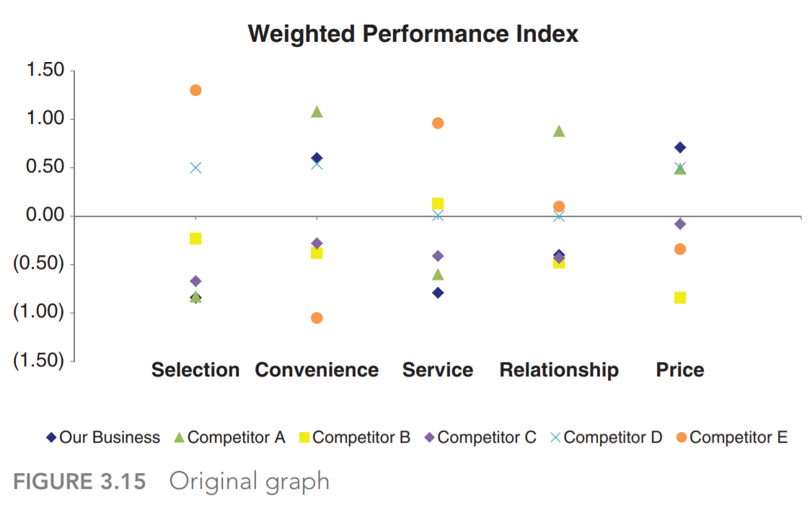
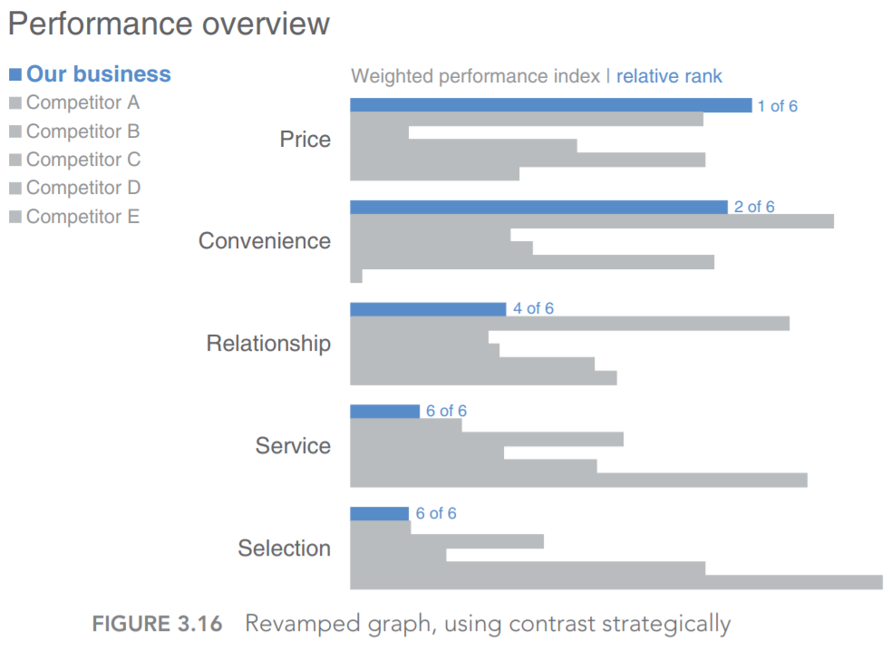
Clutter is your enemy

Slide 22
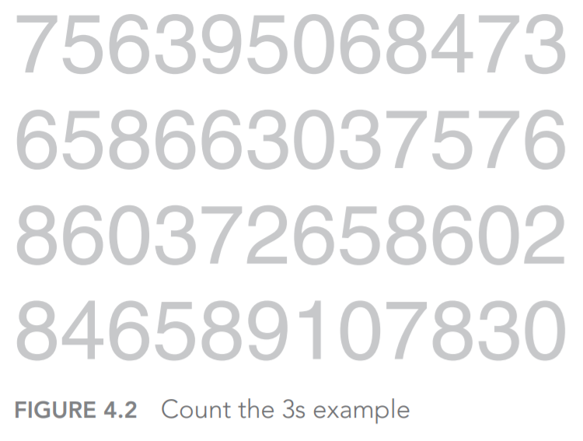
Focus audience’s attention
Pre-attentive attributes signal where to look

Slide 23
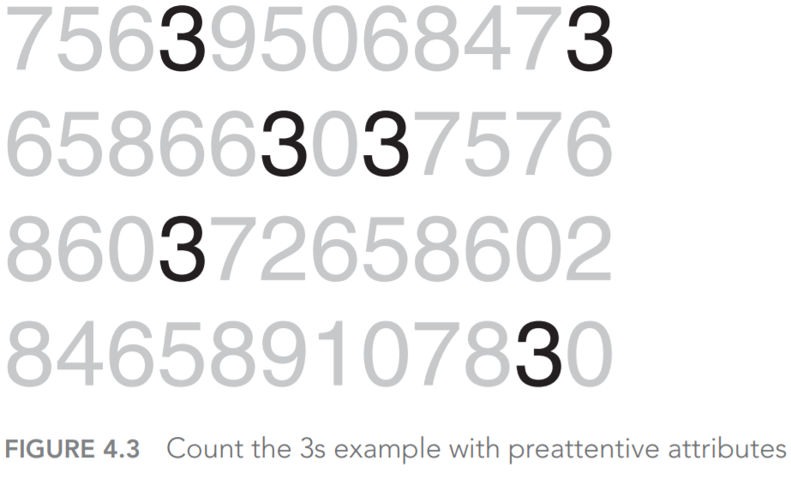
Focus audience’s attention
Enable our audience to see what we want them to see before they even know they’re seeing it!

Slide 24
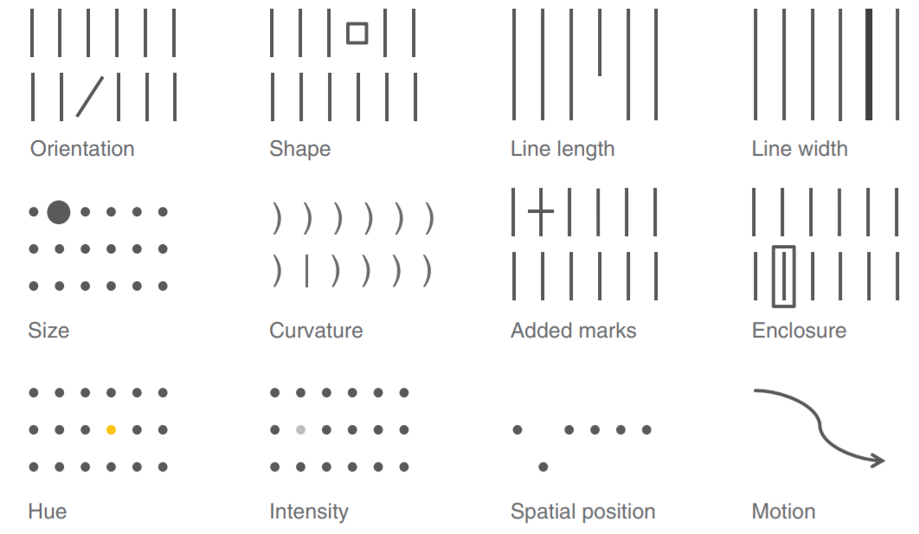
Focus audience’s attention
Preattentive attributes:
Most people will consider a long line to represent a greater value than a short line

Slide 25
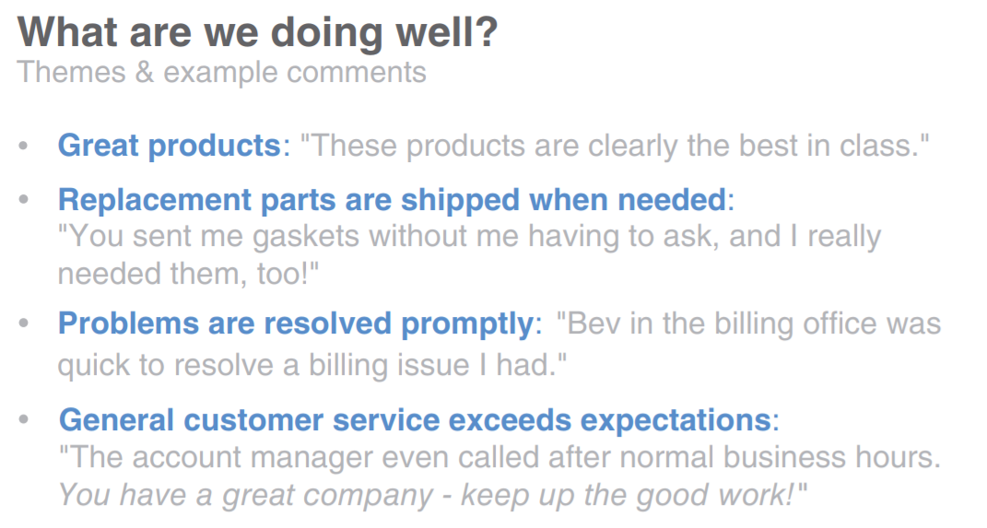
Focus audience’s attention
Preattentive attributes in text
Create visual hierarchy

Slide 26
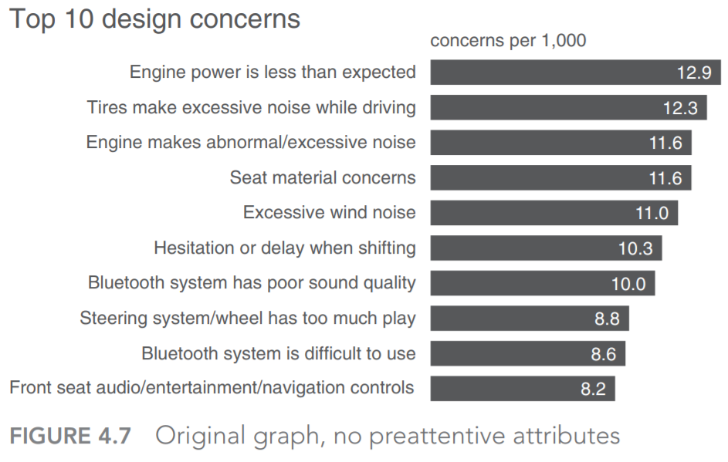
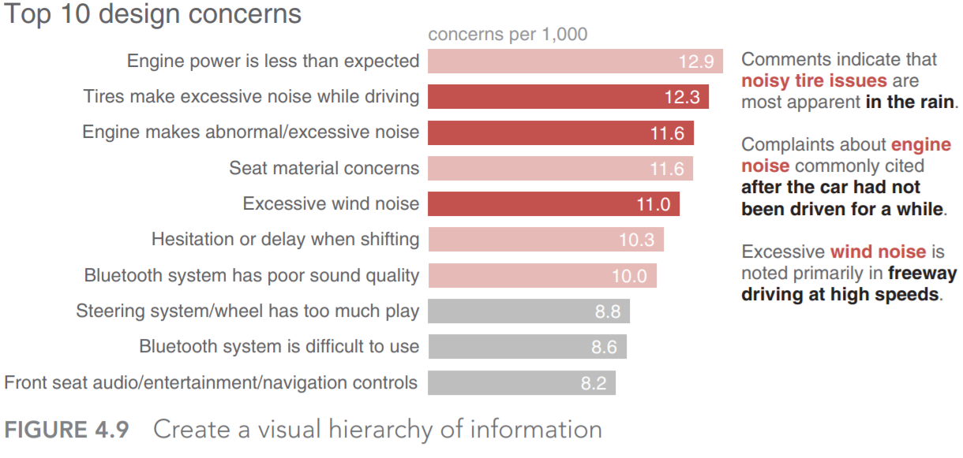
Focus audience’s attention

Slide 27
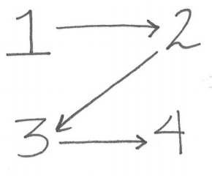
Focus audience’s attention
Position on page

Slide 28
Think like a designer
Aspects inherent to the design that make it obvious how the product is to be used
Highlight the important stuff
Eliminate distractions
Create a clear hierarchy of information
Don’t overcomplicate
Make it legible
Keep it clean
Use straightforward language
Remove unnecessary complexity
Text is your friend
Be smart with color
Pay attention to alignment
Leverage White space
Articulate the benefits of the new or different approach
Show the side‐by‐side
Provide multiple options and seek input
Get a vocal member of your audience on board

Slide 29
Think like a designer
Some specific considerations to help you identify potential distractions:
Not all data are equally important. Use your space and audience’s attention wisely by getting rid of noncritical data or components.
When detail isn’t needed, summarize. You should be familiar with the detail, but that doesn’t mean your audience needs to be. Consider whether summarizing is appropriate.
Ask yourself: would eliminating this change anything? No? Take it out! Resist the temptation to keep things because they are cute or because you worked hard to create them; if they don’t support the message, they don’t serve the purpose of communication.
Push necessary, but non‐message‐impacting items to the background. Use your knowledge of preattentive attributes to de‐ emphasize. Light grey works well for this.

Slide 30

Think like a designer

Slide 31

Think like a designer

Slide 32

Think like a designer

Slide 33
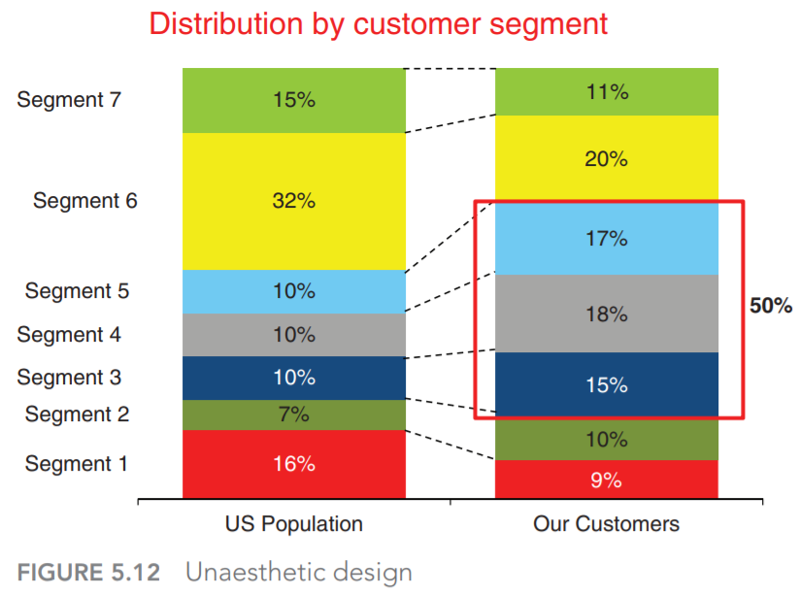
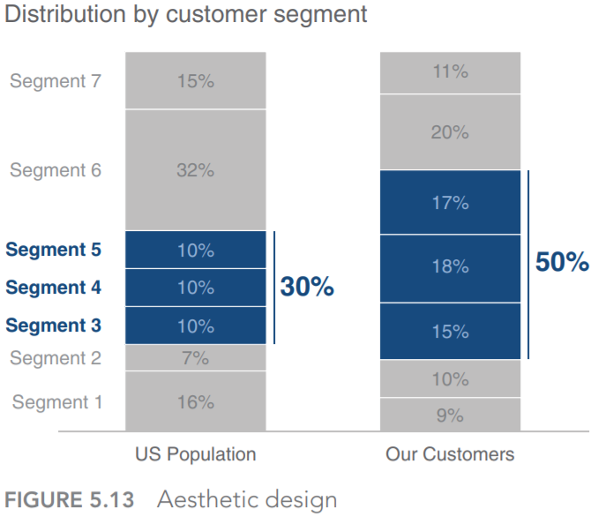
Think like a designer

Slide 34
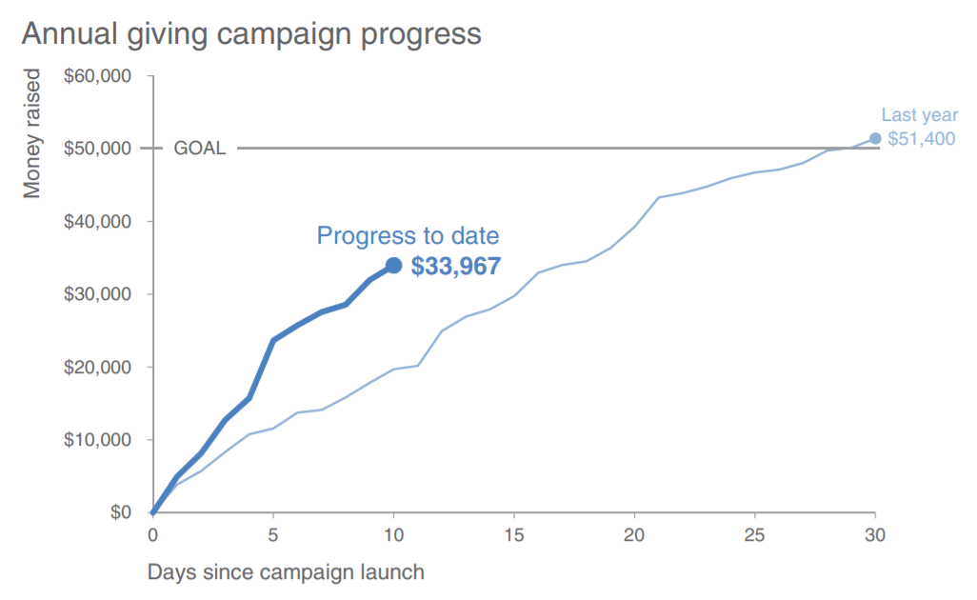
Model visual 1
Company X runs an annual month‐long “giving campaign” to raise money for charitable causes. This year’s progress to date.

Slide 35
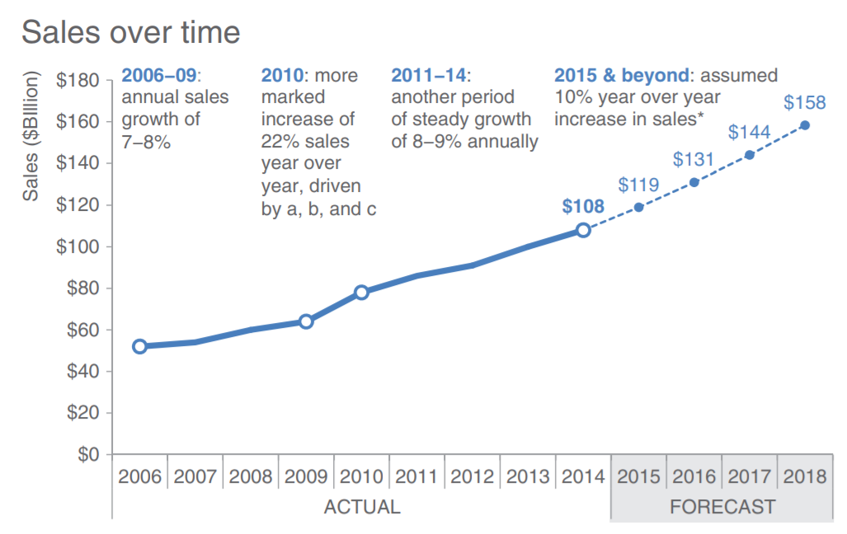
Model visual 2

Slide 36
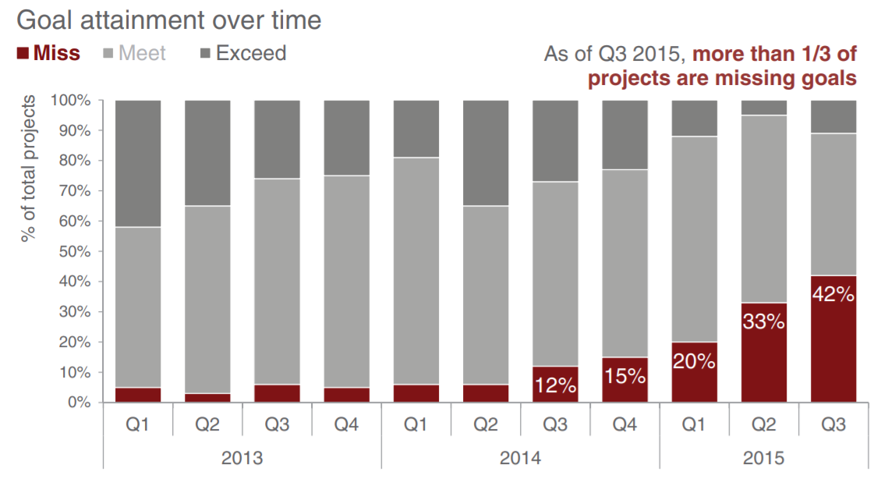
Model visual 3

Slide 37
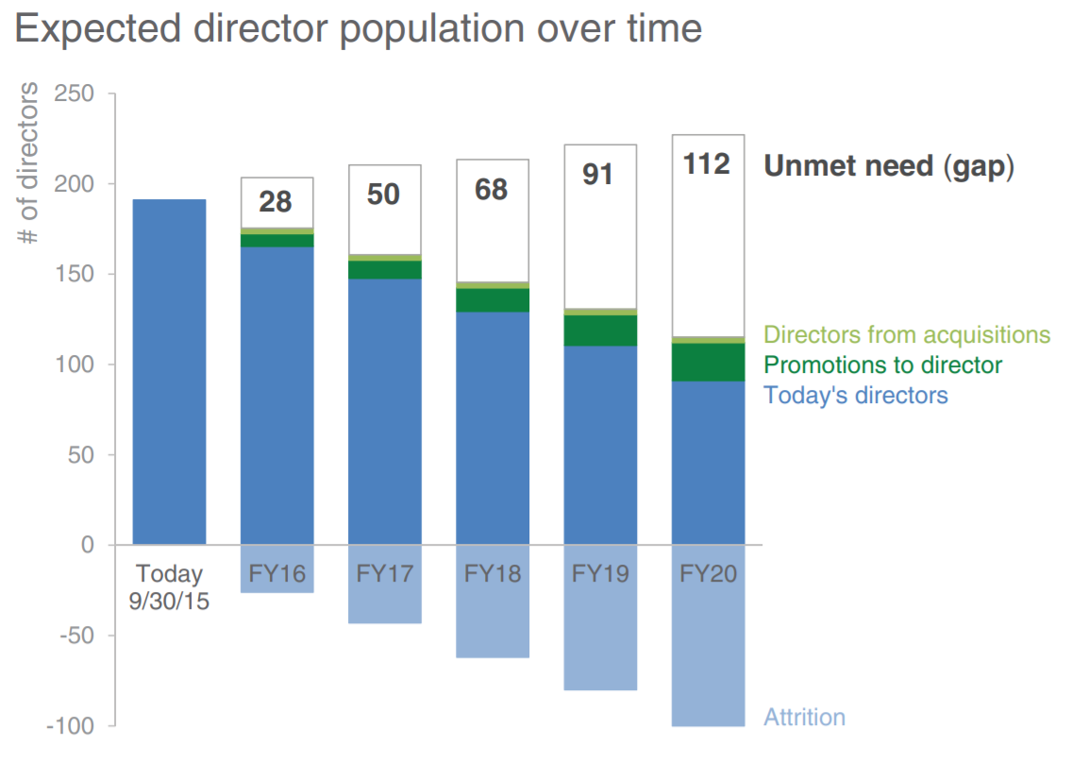
Model visual 4

Slide 38
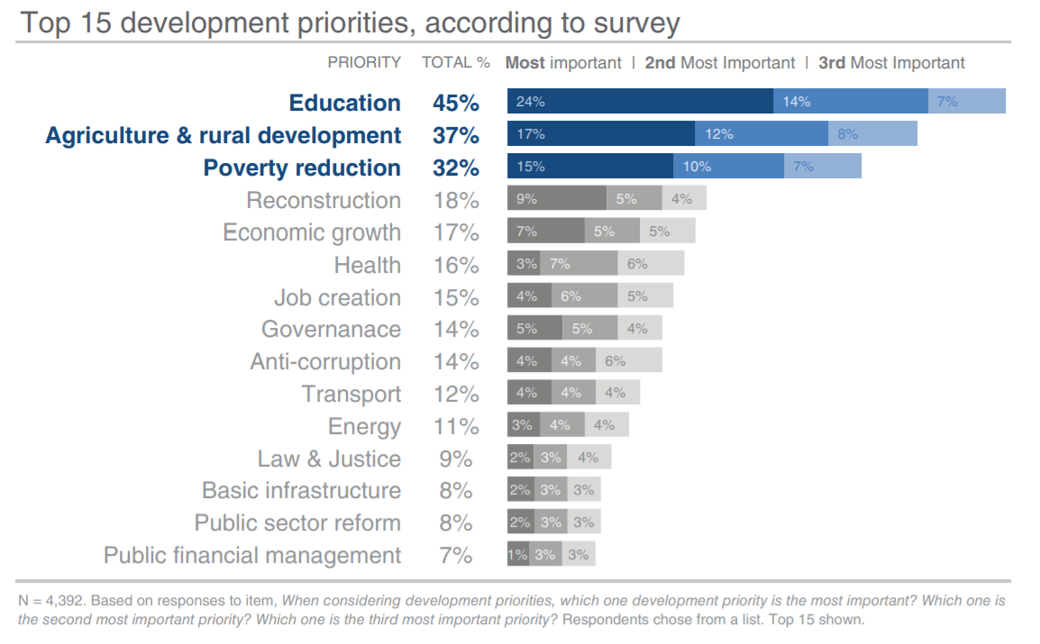
Model visual 5

